Slide 1
Pre-medical Studies at Fresno State
Larry G. Riley, MSc, PhD
Professor – Comparative Endocrinology
Pre-Med Advisor
Biology Department
California State University, Fresno
Science 1, room 212
lriley@csufresno.edu
Appointments are made with the Biology department @ 278-2001

Slide 2
The Journey Towards a Medical Doctor (MD) & Doctor of Osteopathy (DO) Requirements

Slide 3
Pathway to Medical Doctor (MD)
www.aamc.org
**The Medical School Admissions Requirement (MSAR) is published every year. It is a valuable resource. Access it on the aamc website.**
I strongly encourage you to pay for access when you get close to applying to medical school.

Slide 4
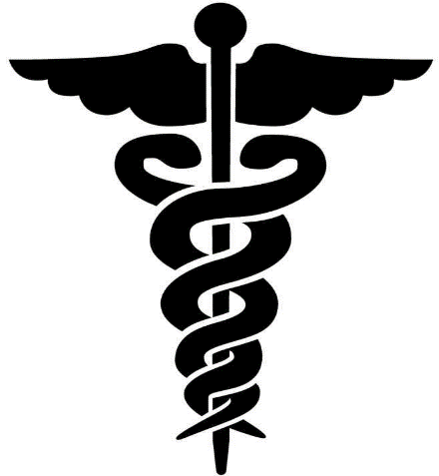
PLAN FOR MEDICAL SCHOOL
126 MD-granting accredited US Medical Schools
34 Osteopathic Medical Colleges
17 Canadian Medical Colleges

Slide 5
The Path
Medical Education Timeline
5 years
4 years
3-7 years
1-3 years
Undergraduate study* (Bachelors degree)
Medical Degree
Internship/Residency
Specialty Fellowship
Board Certification/Licensure
12-19 Years
*Possibly Post Baccalaureate program work to shore up soft GPA (+1 year)

Slide 6
What Should I Major In?
Whatever interests you the most, BUT...
English, philosophy, history, music majors, etc… will take longer to graduate to get all of the pre-req’s, low registration priority science courses, and science GPA is vulnerable.
Advantages of Biology or Chemistry major
Premed pre-req’s are part of the degree requirements
Better preparation for first year of med school
Higher priority at getting into impacted first year Chem 1A/1B and Biol 1A/1B.
There is no statistical advantage in matriculation rates for non-science majors.

Slide 7
Have A Plan
Academics - Required Courses
Bachelor’s Degree
Extracurricular Activities
medical experience (Scribe, shadowing, paid)
Community Service (a long-term commitment)
MCAT
Research!!!!!
Letters of Recommendation (get to know your professors)
Finances for the Application Process

Slide 8
Undergraduate Academic Preparation
1 year of General Chemistry (1A and 1B). NOT Chem 3A/3B
1 year of Organic Chemistry with lab 128 A & 129A, then 128B and 129B)
1 year of General Biology with lab (Biol 1A and 1B). NOT Biol 10
1 year of physics with lab (Phys 2A/B; Does not have to be physics for physics majors).
1 year of Math
1 semester of calculus (Math 75) + statistics (Psych 42 or Math 101) or
2 semesters of calculus (Math 75 & 76)

Slide 9
AP & Junior College Credit
This is tricky. More and more medical schools are accepting AP & Community College pre-req credit.
However, you will be better prepared for our upper level courses if you take all science courses at a 4-year University
In general, we advise pre-med students to take general chemistry and biology at Fresno State (not a community college) even if they have AP credit for these courses.
We do not know if students that use AP credit are at a disadvantage when applying to medical school.
Remember you are competing for a spot, do everything you can to make you the best possible applicant!!!

Slide 10
Courses Required or Recommended by Many Medical Schools (and really important for the MCAT)
1 year of English
1 lower division + 1 upper division (lots of reading, critical thinking, and writing; or Philosophy courses
Behavioral Sciences courses (1-2 courses)
Psychology, sociology, history, anthropology, etc…
Dependent upon medical school
1 semester of Biochemistry

Slide 11
Other Courses
• Physiology (Comparative or Human; can help with the MCAT)
Genetics (can help with the MCAT, req’d by some medical schools)
Human Anatomy (just before entering; can help with first year med school)
Cell Biology & Molecular Biology (can help with first year med school)

Slide 12
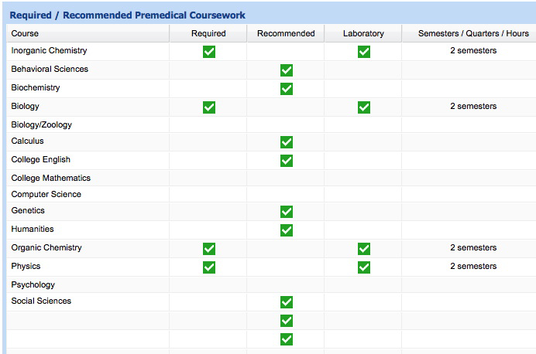
Required & Recommended Courses Vary Between Medical Schools
Stanford = Irvine =
Upper Division Biology
Statistics

Slide 13
!make sure that you have fulfilled the course requirements for the medical schools to which you intend to apply!
Before applying
Contact each medical school you are applying to and/or review the MSAR (purchase on www.aamc.org)

Slide 14
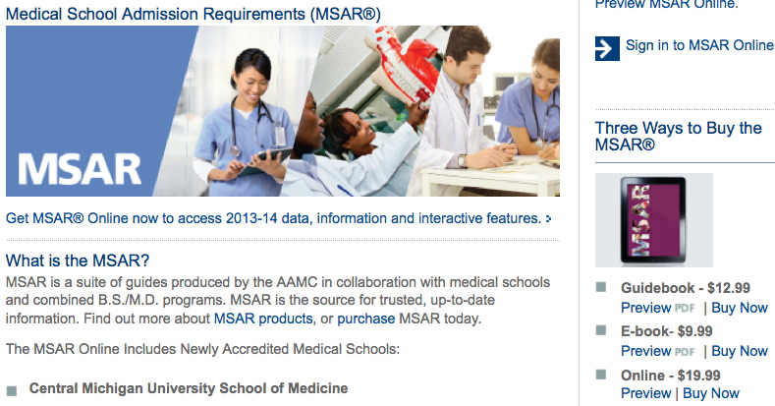
www.aamc.org/msar

Slide 15
Academics Count
Aim for a minimum 3.6 GPA, for BOTH your overall GPA as well as your BCMP (Biology, chemistry, math and physics) GPAs.
For allopathic medical schools (DO), the GPA is calculated based on all courses taken, even those for which you applied for grade substitution. GPA scores are a little lower.

Slide 16
Schools with multiple CSUF acceptances 2015/16-2017/18
Medical School | Location | CSUF Students Accepted | Ave. GPA of all Students (from all Univ.) 2017-18 | Ave. MCAT of all students (from all Univ.) 2017-18
Albert Einstein | New York, NY | 1 | 3.82 | 515
Boston Univ. | Boston, MA | 6 | 3.83 | 518
Brown Univ. | Providence, RI | 2 | 3.79 | 515
California Northstate Univ. | Elk Groove, CA | 2 | 3.64 | 513
Case Western Univ. | Cleveland, OH | 4 | 3.82 | 506
Creighton | Omaha, NE | 1 | 3.82 | 510
Drexel Univ. | Philadelphia, PA | 2 | 3.76 | 511
Eastern Virginia | Norfolk, VA | 1 | 3.67 | 513
George Washington | Washington, DC | 2 | 3.72 | 511
Harvard | Boston, MA | 2 | 3.92 | 519
Howard | Washington, DC | 1 | 3.45 | 502
Indiana | Bloomington, IN | 2 | 3.82 | 511
Mayo Clinic | Rochester, MN | 4 | 3.91 | 517
Medical College Wisconsin | Milwaukee, WI | 2 | 3.79 | 511
Morehouse | Atlanta, GA | 1 | 3.61 | 504
Mount Sinai | New York, NY | 1
New York Univ. School of Medicine | New York, NY | 2 | 3.92 | 521
Northwestern | Evanston, IL | 2 | 3.91 | 520
Oakland Univ. William Beaumont School of Medicine | Auburn Hills, MI | 2 | 3.8 | 510
State Univ. of NY, Downstate-SUNY | Brooklyn, NY | 1 | 3.76 | 514
St. Louis Univ. School of Medicine | St. Louis, MO | 3 | 3.89 | 513
Stony Brook Univ. | Stony Brook, NY | 1 | 3.82 | 514

Slide 17
Cont. Schools with multiple CSUF acceptances 2015/16-2017/18
Medical School | Location | CSUF Students Accepted | Ave. GPA of all students (from all Univ.) 2017-18 | Ave. MCAT of all students (from all Univ.) 2017-18
Temple | Philadelphia, PA | 1 | 3.75 | 512
UC Berkeley | Berkeley, CA | 1
UC Davis | Davis, CA | 12 | 3.72 | 512
UC Irvine | Irvine, CA | 8 | 3.82 | 515
UC Riverside | Riverside, CA | 5 | 3.68 | 509
UC San Diego | San Diego, CA | 3 | 3.8 | 517
UC San Francisco | San Francisco, CA | 7 | 3.85 | 517
UCLA | Los Angeles, CA | 5 | 3.85 | 517
Uniformed Services Univ. of Heath Sciences | Bethesda, MD | 1 | 3.7 | 510
Univ. of Arizona College of Medicine | Tucson, AR | 1 | 3.72 | 508
Univ. of Cincinnati | Cincinnati, OH | 1 | 3.84 | 517
Univ. of Illinois | Champaign, IL | 1 | 3.73 | 512
Univ. of Iowa | Iowa City, IA | 1 | 3.83 | 514
Univ. of Tennessee | Knoxville, TN | 2 | 3.77 | 510
Univ. of Washington | Seattle, WA | 2 | 3.71 | 510
Univ. of Wisconsin | Madison, WI | 2 | 3.84 | 513
USC-Keck School of Medicine | Los Angeles, CA | 5 | 3.78 | 517
Virginia Commonwealth Univ. | Richmond, VA | 3 | 3.74 | 511
Vermont Univ. | Burlington, VT | 1 | 3.74 | 511
Wake Forest | Winston-Salem, NC | 2 | 3.69 | 511

Slide 18
2017 Data
30 CSUF students applied, 12 were admitted to at least 1 school: 40% acceptance rate.
Highest MCAT with acceptance: 522
Lowest MCAT with acceptance: 504
Highest GPA: 4.0
Lowest GPA: 3.52

Slide 19
Doctor of Osteopathy?

Slide 20
What is Osteopathic Medicine?
Osteopathic physicians use all of the knowledge, skills, tools, and technology available in modern medicine, with the added benefits of a holistic philosophy and a system of hands-on diagnosis and treatment known as osteopathic manipulative medicine (OMM).
Doctors of osteopathic medicine (DOs) emphasize helping each person achieve a high level of wellness by focusing on health promotion and disease prevention.
DOs work in partnership with their patients.
DOs emphasize helping each person achieve a high level of wellness by focusing on health promotion and disease prevention.
They consider the impact that lifestyle and community have on the health of each individual, and they work to erase barriers to good health.

Slide 21
What is Osteopathic Medicine? (cont.)
There are more than 96,000 DOs in the United States
DOs practice the full scope of medicine in all specialties of the medical field, from pediatrics and geriatrics to sports medicine and trauma surgery.
DOs receive the same medical training as other physicians, as well as 200 additional hours of OMM training. OMM is a hands-on therapy used to diagnose and treat illness and injury.
The American Osteopathic Association (AOA) maintains an online national directory of practicing DO’s that you should contact to find a DO to shadow.
www.aacom.org

Slide 22
What is Osteopathic Medicine? (cont..)
Medical Education Timeline
5 years
4 years
3-7 years
1-3 years
Undergraduate study (Bachelors degree)
Osteopathic Medical Degree
Internship/Residency
Specialty Fellowship
Board Certification/Licensure
12-19 Years
Residency Match: 99.61% in 2016

Slide 23
What is Osteopathic Medicine? (cont…)
Mean GPA & MCAT of Entering Students
 | 2016 | 2017
Science | 3.5 | 3.43
Non-Science | 3.65 | 3.64
Mean GPA | 3.56 | 3.53
MCAT Scores | 502 | 503

Slide 24
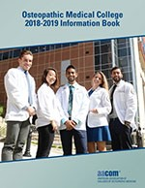
Osteopathic Medical Colleges
www.aacom.org
There are currently 34 colleges of osteopathic medicine, offering instruction at 51 locations in 32 states.
The requirements are the same as applying to MD schools.

